Slide 1
Optimizing Trading Strategies with Reinforcement Learning
Amulya Saxena
Travis Desell

Slide 2
Agenda – Stand up I
Update
Code Commits
Experiments

Slide 3
Update
Mid July – researched and documented next steps for fall semester
End Aug – Started studying and coding momentum-based strategies
Mid Sept – Experimenting with Moving averages and Relative strength index
Notes:
The only hold up is that, I need to see a lot of videos understanding the technical terms
- As each strategy is different and involves different components

Slide 4
Update
Implemented
Simple Moving averages(MA) strategy
Back Testing in progress
Relative Strength Index(RSI)
Combined with MA
Planned
EMA, WMA, CMA and pick the best
Moving average Convergence divergence(MACD) + RSI
Notes:
Back testing is the process of evaluating a trading strategy or investment model by applying it to historical data to see how it would have performed in the past.

Slide 5
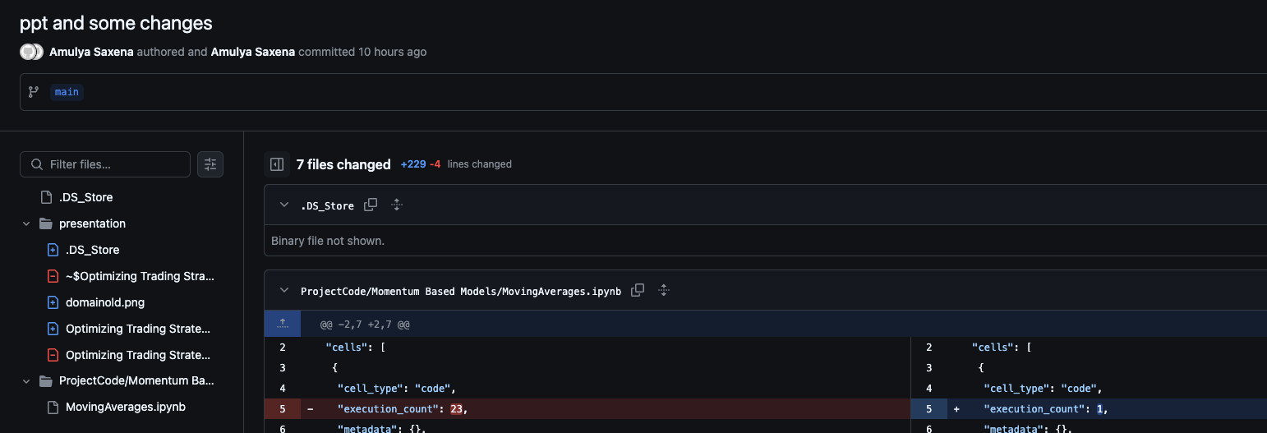
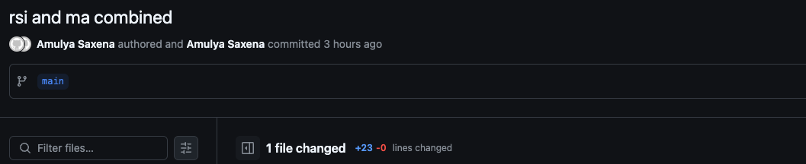

Slide 6
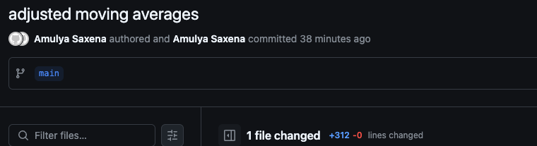
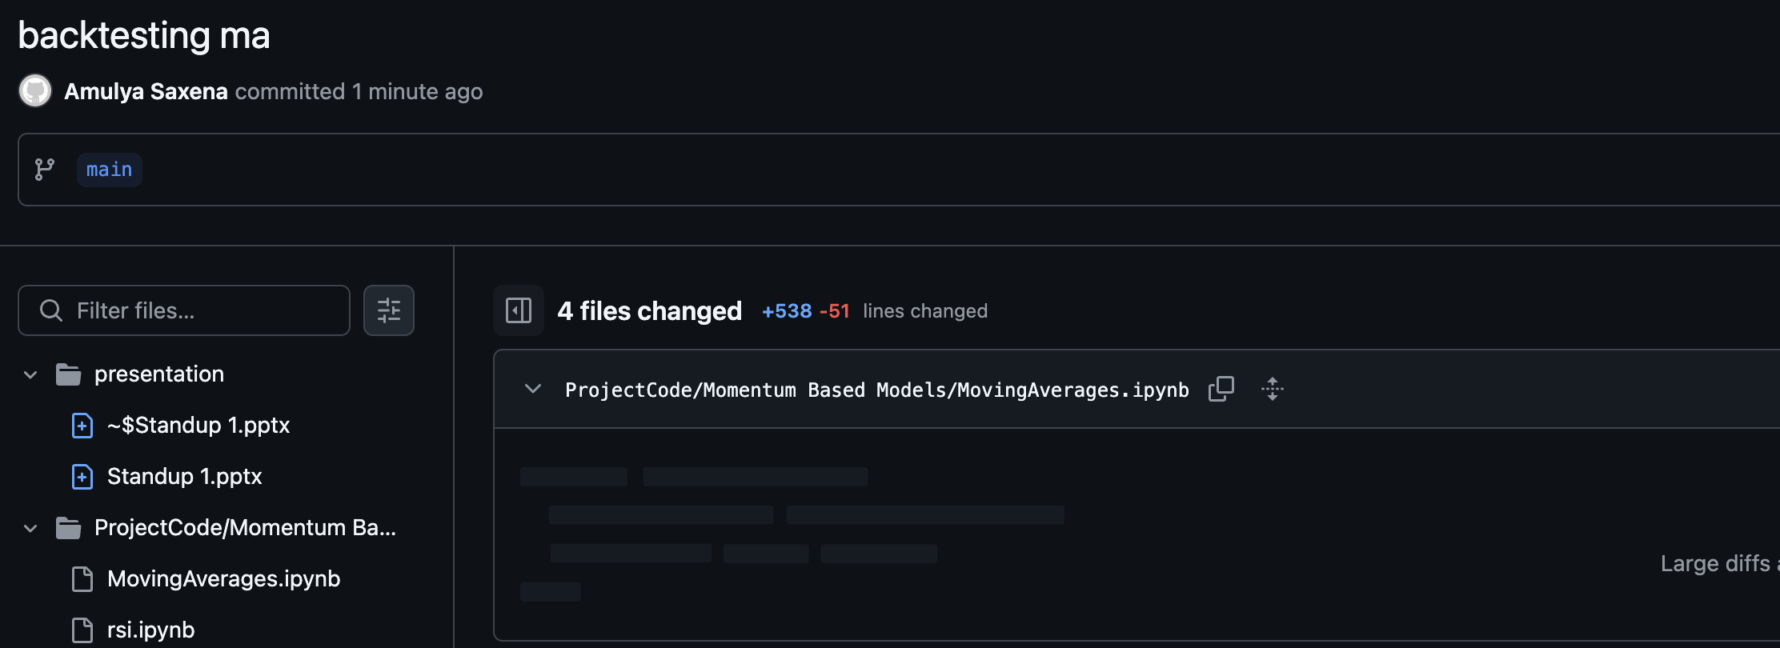

Slide 7
Experiments
Evaluating using performance metrics
Back testing Moving averages
Notes:
Total Return shows how much profit the strategy made as a percentage of the initial capital.
Max Drawdown shows the worst-case scenario of how much the portfolio could have lost from its highest point.
Sharpe Ratio evaluates how much return you earned for the risk you took, with a higher ratio indicating a better risk-adjusted return.

